Slide 1
Rose City Label Company
Austin Family Business Presentation
June 21, 2013

Slide 2
Overview
Our Proud History
Future Generations
Leadership in the Label Business
Summary and Questions

Slide 3
Our Proud History
Austin Family Business Presentation
June 21, 2013

Slide 4
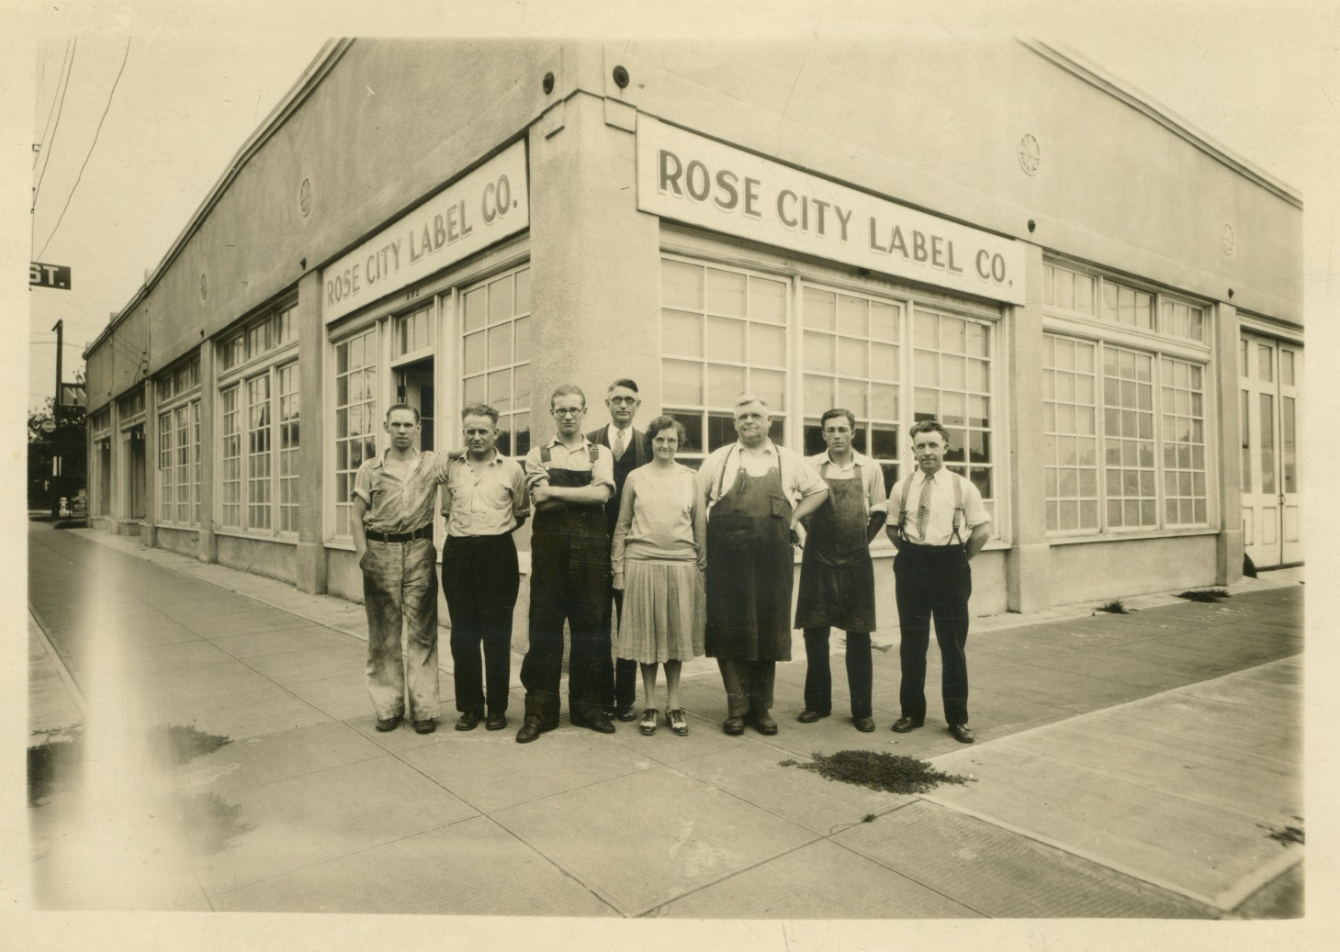
History:
Built on a proud legacy since 1928

Slide 5
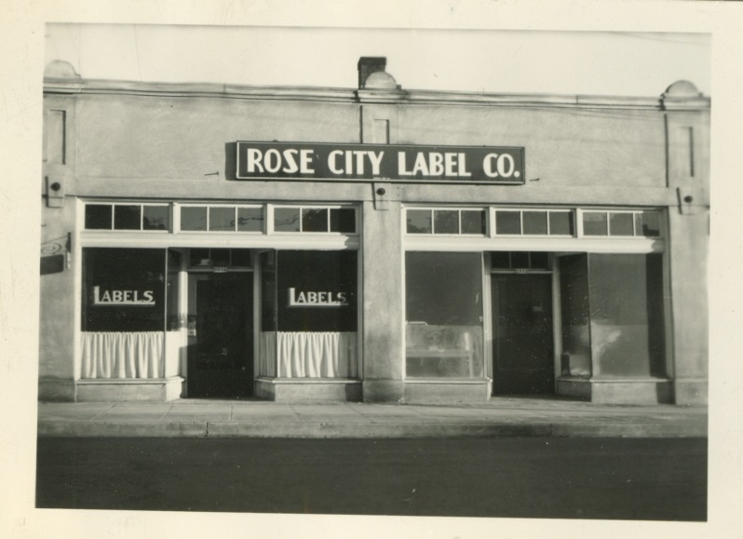
Original Location 1928: 2516 SE Division

Slide 6
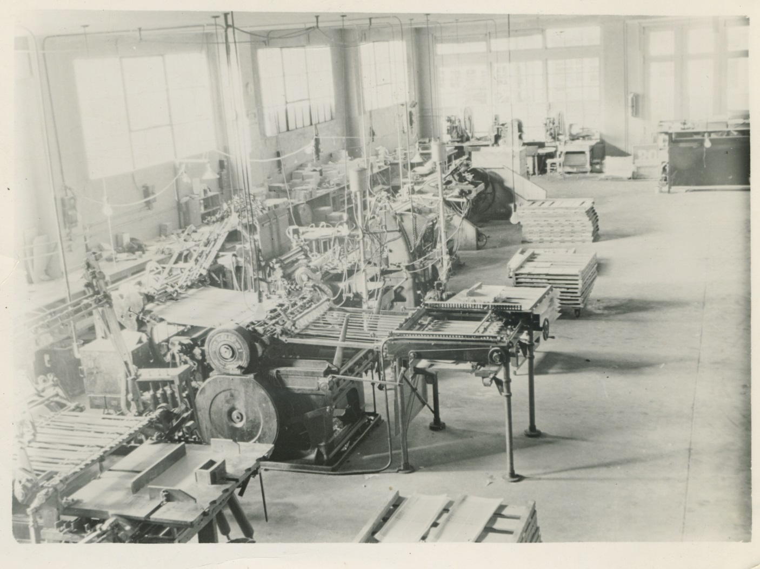
State of the Art Letterpress Equipment

Slide 7
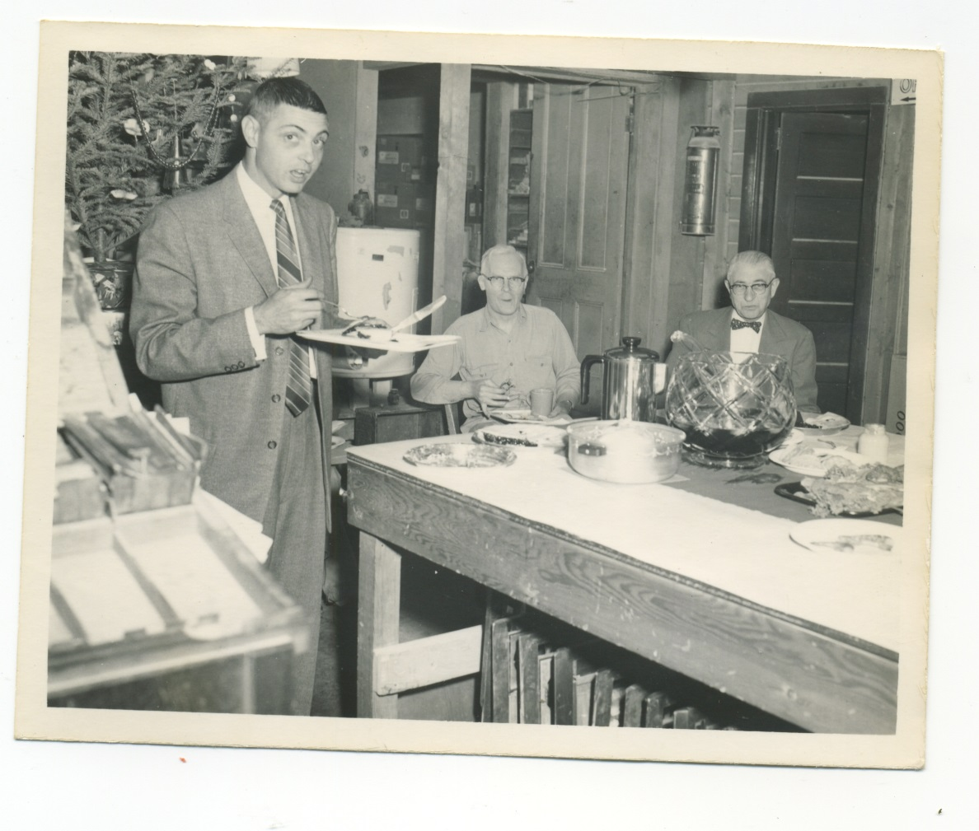
Founding Family – George and Wayne Frie

Slide 8
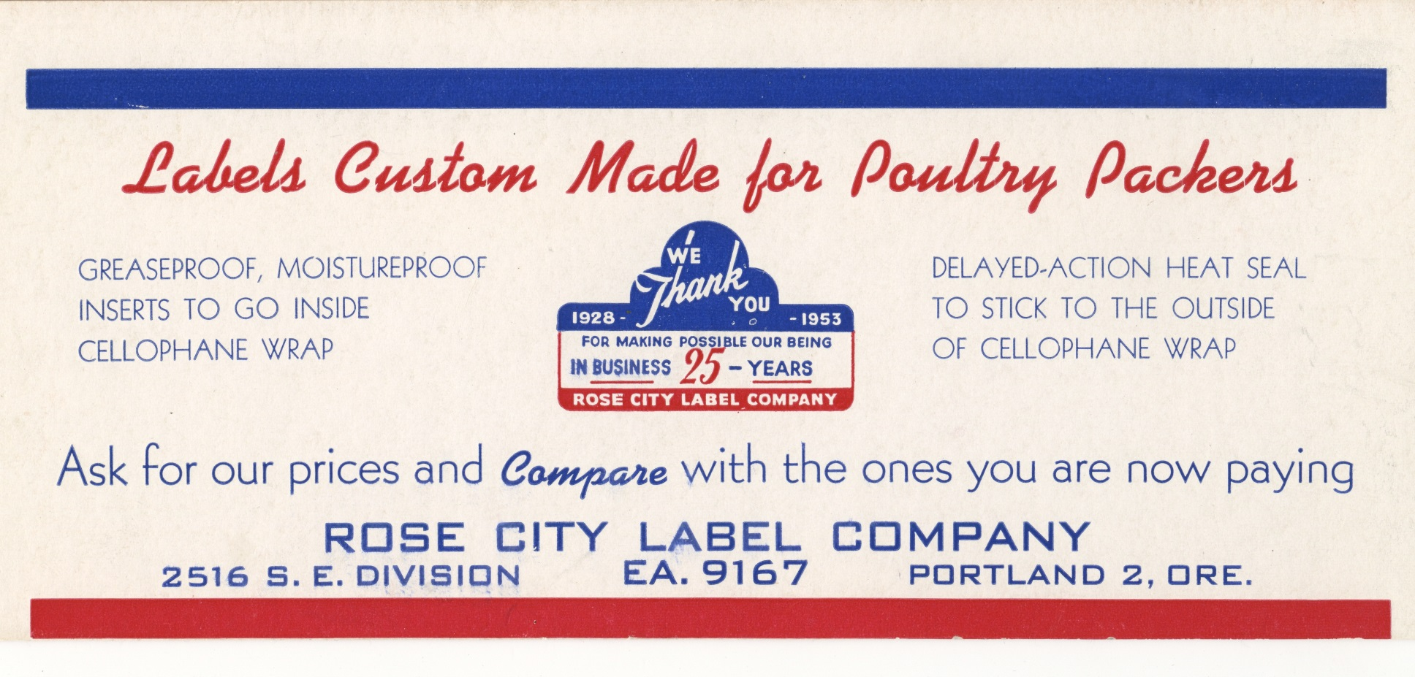
Proud of 25 years in business!

Slide 9
85 Years – 3 Locations
1928-1960 – 2516 SE Division
1960-1970 – 8970 SE Otty Rd
1971-present – 7235 SE Label Lane

Slide 10
Four Generations – Two Families –
One Great Company
George Frie 1928-1958
Wayne Frie 1958-1974
Mike Pillsbury 1974-1998
Scott and Whitney Pillsbury 1998-present

Slide 11
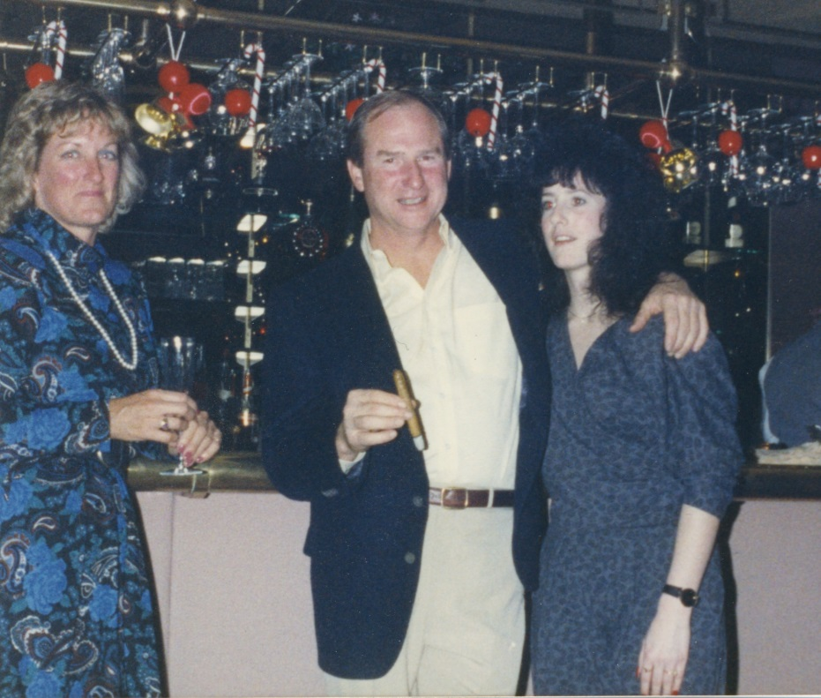
Our Father, Mike, bought the business in 1974

Slide 12
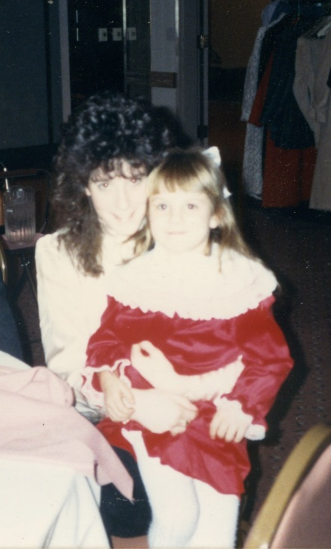
Brooke Pillsbury at Holiday Party in 1987

Slide 13
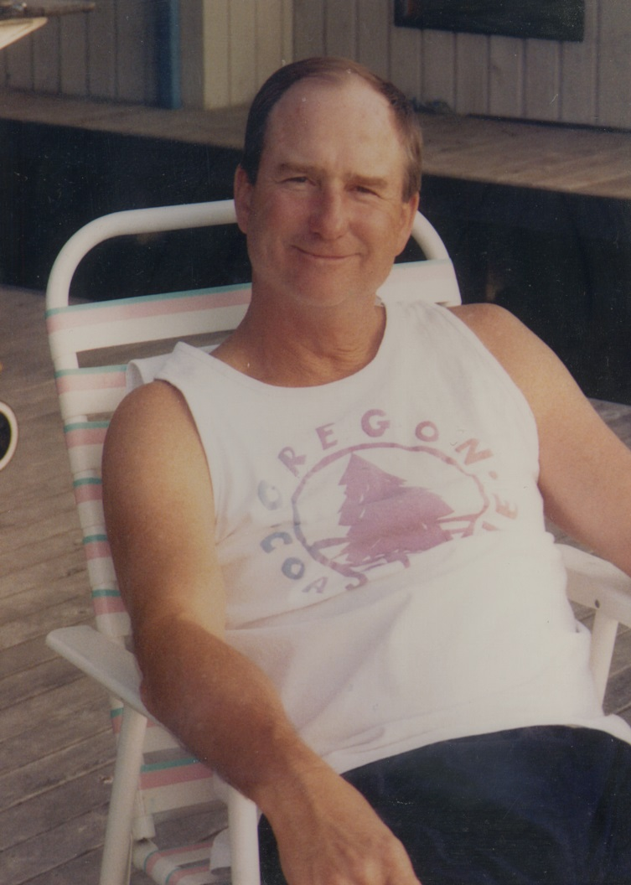
Passed Away Suddenly in 1998

Slide 14
Future Generations
Austin Family Business Presentation
June 21, 2013

Slide 15
Fifth Generation –
Third Generation Pillsbury Family
Whitney’s daughter Brooke, Age 29
  Has worked 5 years at Rose City Label
  Currently getting experience outside the family business
Scott’s children – Anna, 15 and Alex, 10
  No active involvement in the business so far…
Scott, age 47 and Whitney, age 45
  Hope to be running the business for many years

Slide 16
Family Planning…
Although we don’t have a formal succession plan in place, we anticipate Brooke will join the business full time in 2014.
She is excited to carry the legacy forward.

Slide 17
Leadership in the Label Business
Austin Family Business Presentation
June 21, 2013

Slide 18
Rose City Label Today
Tough times in 2008
Industry Leadership through TLMI
Web, blogging, email blasts
Digital Printing is the future
Streamlining Shop Workflow
Digital Plate Making
Eco-Friendliness with Project LIFE
Results and the future

Slide 19
Tough Times in 2008
Overstaffed with new sales people in training
Major drop in sales
Fired one Salesperson and laid off one factory worker
Cut shop to 30 hours per week – kept full benefits
Held on in 2008 despite losses
Back to ‘break even’ status in 2009
Many lessons learned!

Slide 20
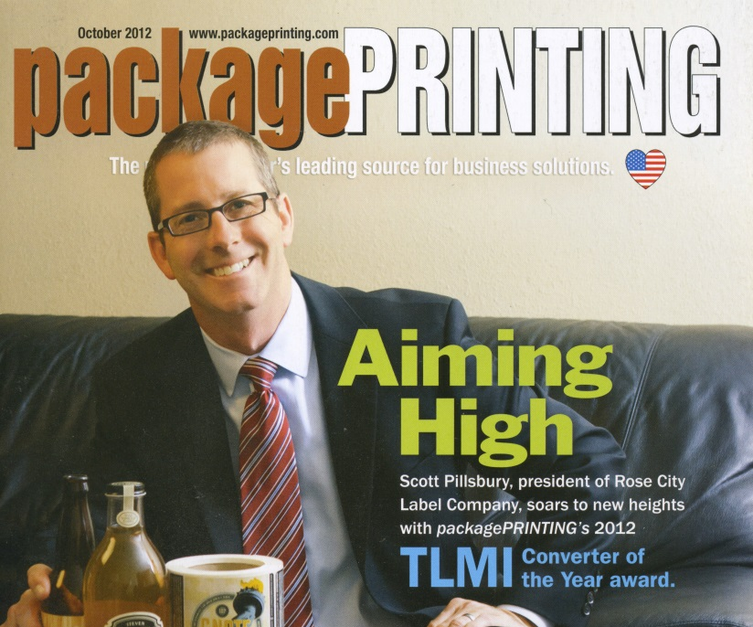
Industry Leadership
National Trade Association – TLMI
Contacts with the biggest and best players in the game
Scott was Board Chair in 2005
Buy and sell from other top specialty producers
Industry Award 2012:

Slide 21
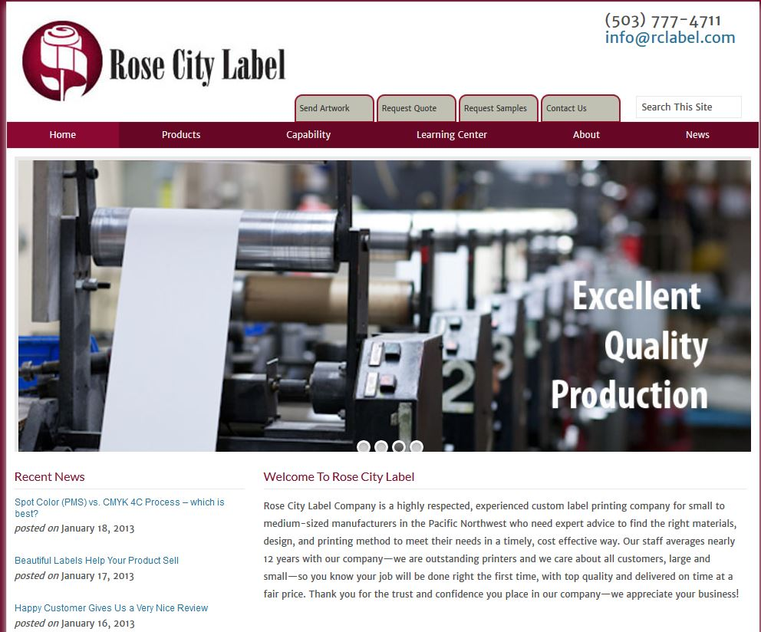
Focus on digital marketing since 2009

Slide 22
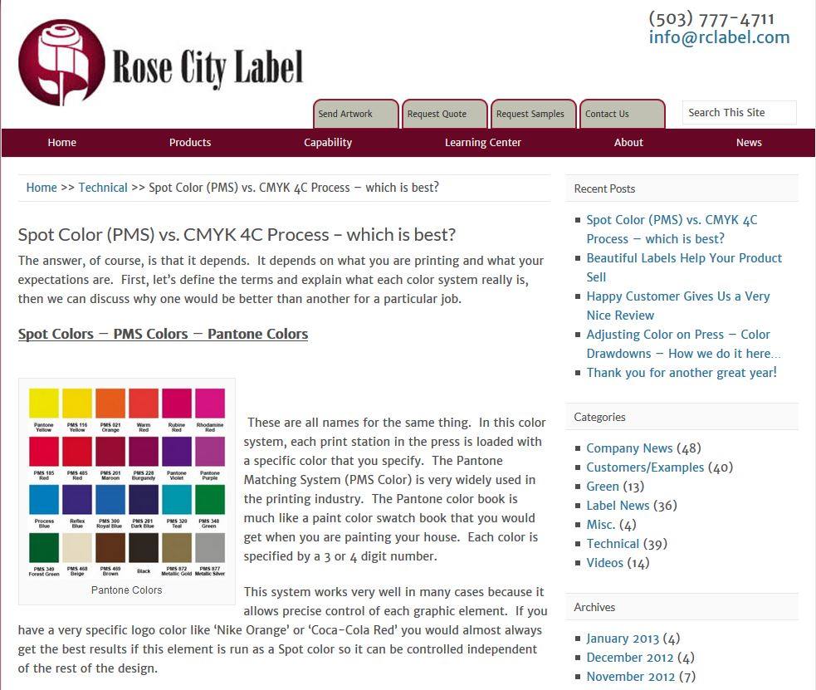
Weekly blog updates – tech, examples, etc

Slide 23
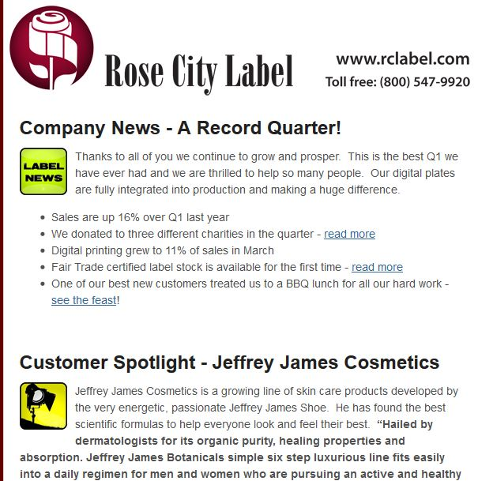
Quarterly Email Newsletter – 2500 readers

Slide 24
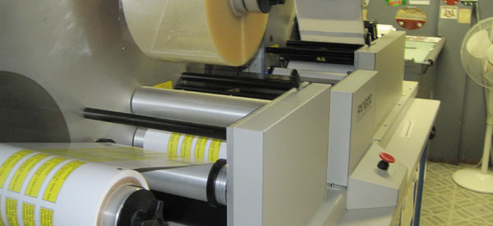
Digital Printing is the Future
Exceptional Quality
Fast Turn Around – Economical for Short Runs
Low Setup Time and Low Waste
Any Color – Any Material – Any Size and Shape
Very Eco-Friendly

Slide 25
Streamlined Shop Workflow
Quote, order, shipping and invoice all in one package
Faster, more accurate quotes
Better scheduling, better status updates
PDF quotes, invoices, packing lists, tracking
Expandable for the future – web orders, job costing

Slide 26
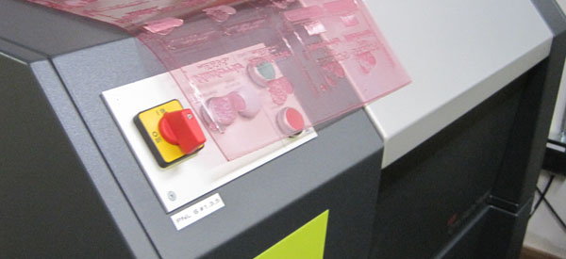
Digital Plate Making

Slide 27



Sustainability as a Way of Life
Clackamas County BRAG 2009
  Renewed BRAG 2014
TLMI Project LIFE Audit August 2014
  First in Pacific Northwest

Slide 28
Results and the Future
We have 15 highly trained, well paid employees
Average tenure is 13 years with Rose City Label
Over 1,000 visits to our website each month
2012 was excellent – sales up 9% over 2011
145 New Customers in 2012
Q1 2013 was best Q1 ever – up 16% over Q1 2012
May 2013 was best month in 85 years!
Investing in more digital equipment for the future

Slide 29
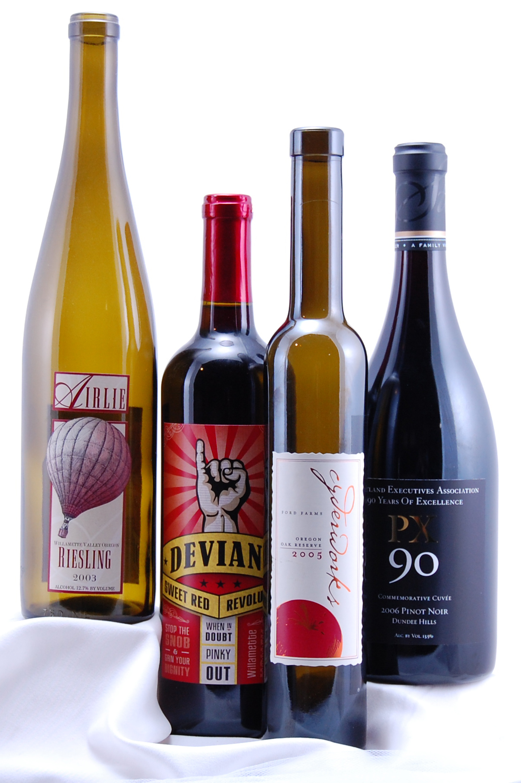
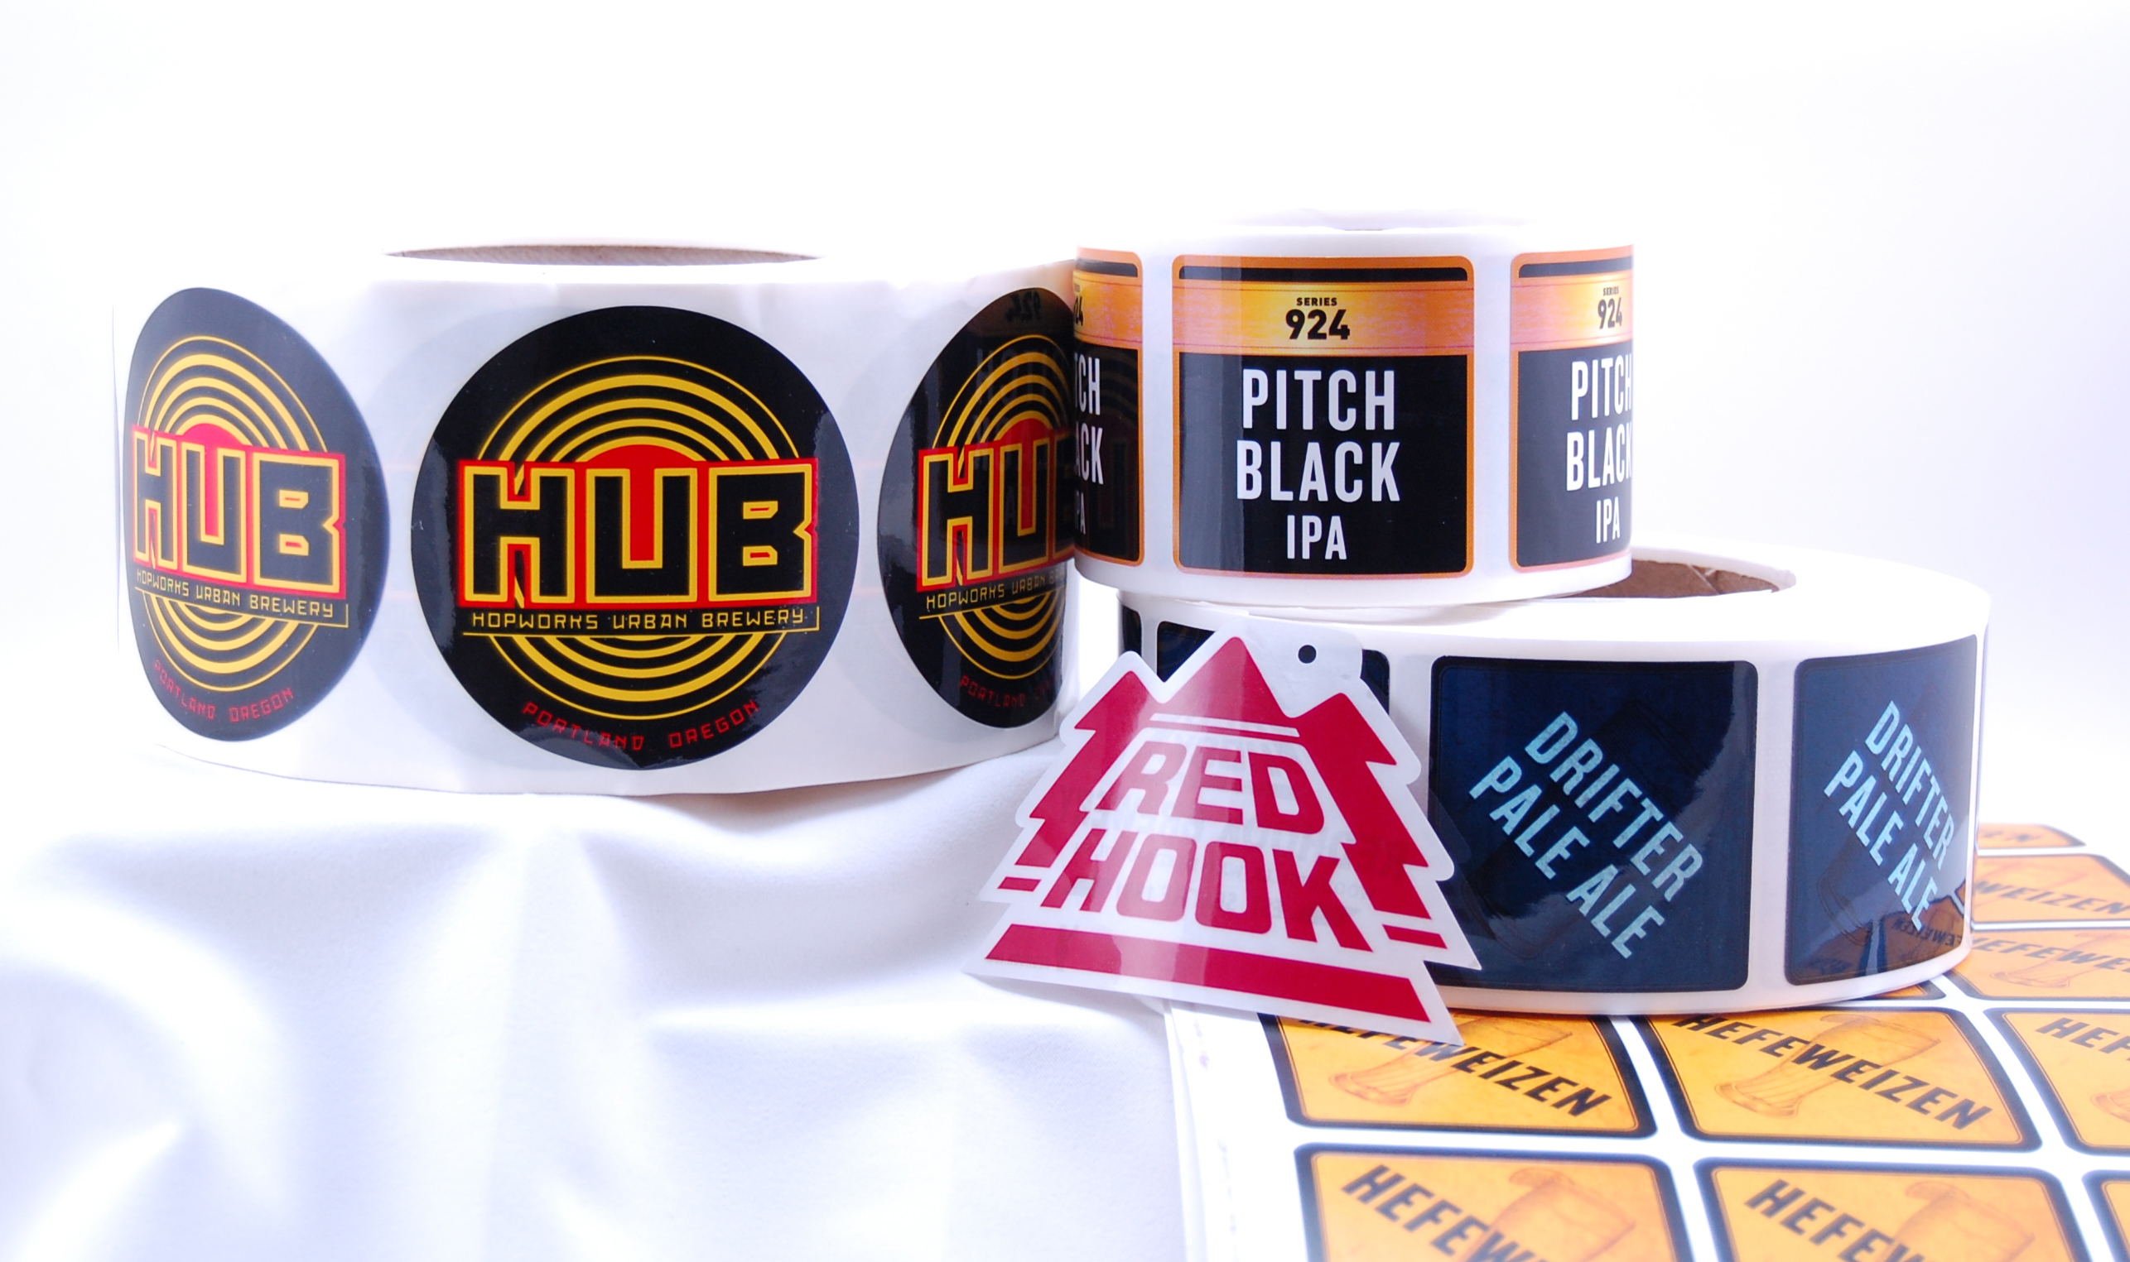
Beer, Wine and Food Labels
Barcodes
Warning and Safety Labels
Foil Stamping
Stickers
Logo Labels
Promotional Labels

Slide 30
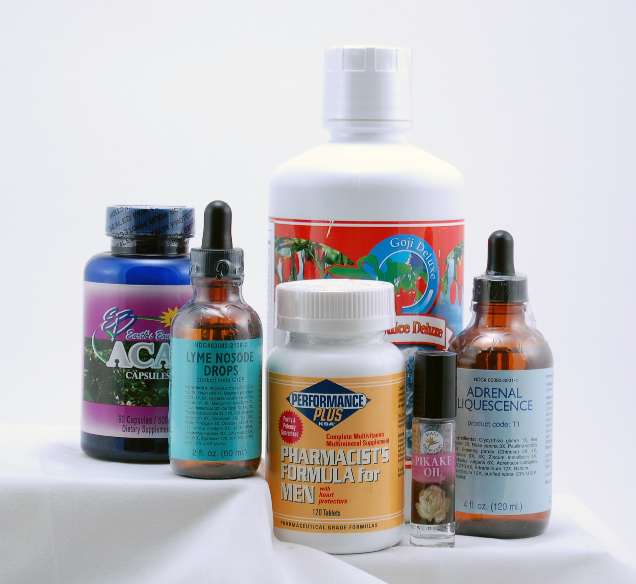
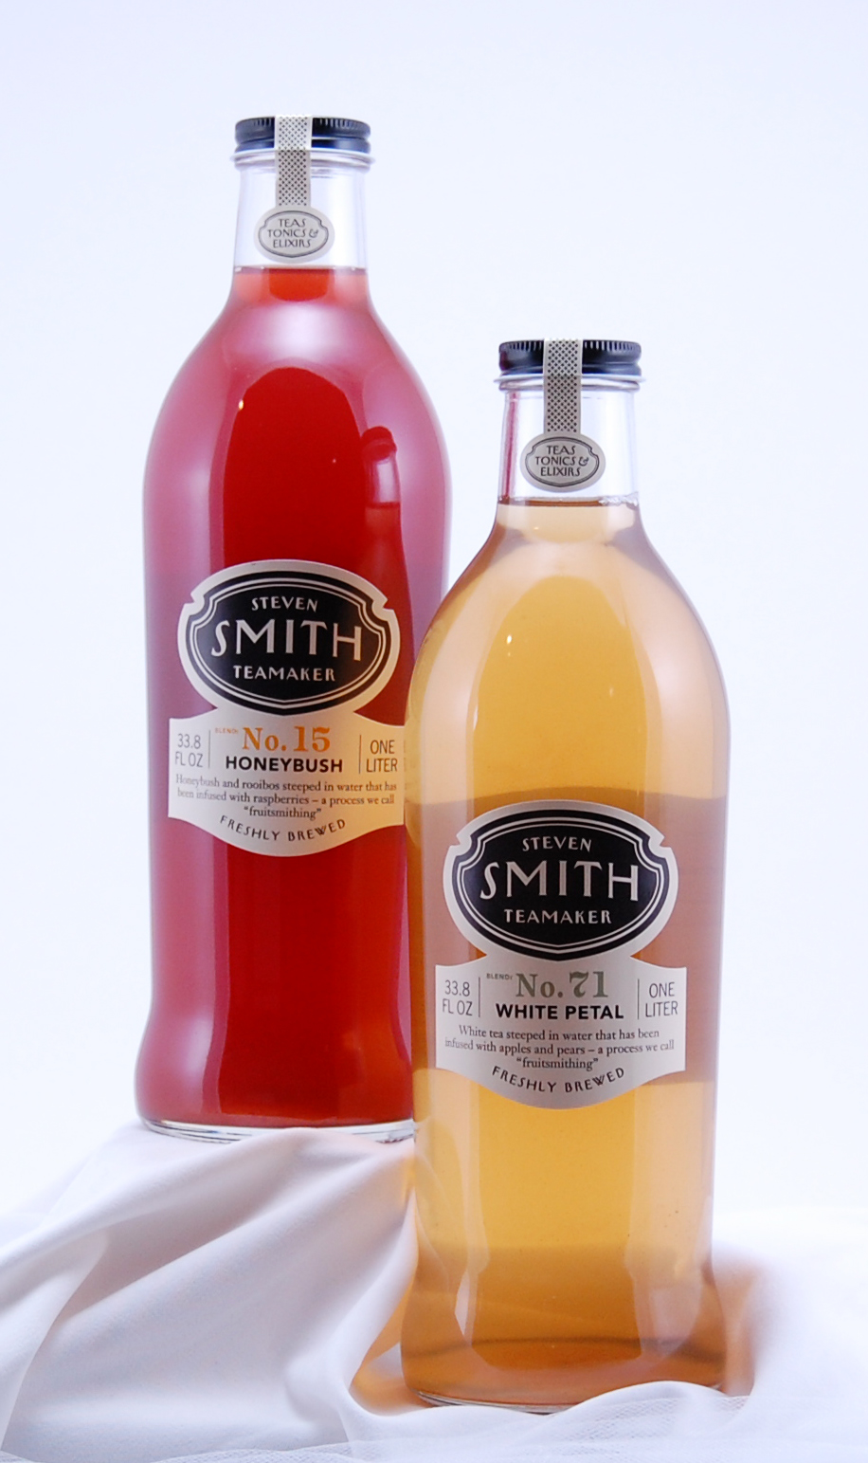
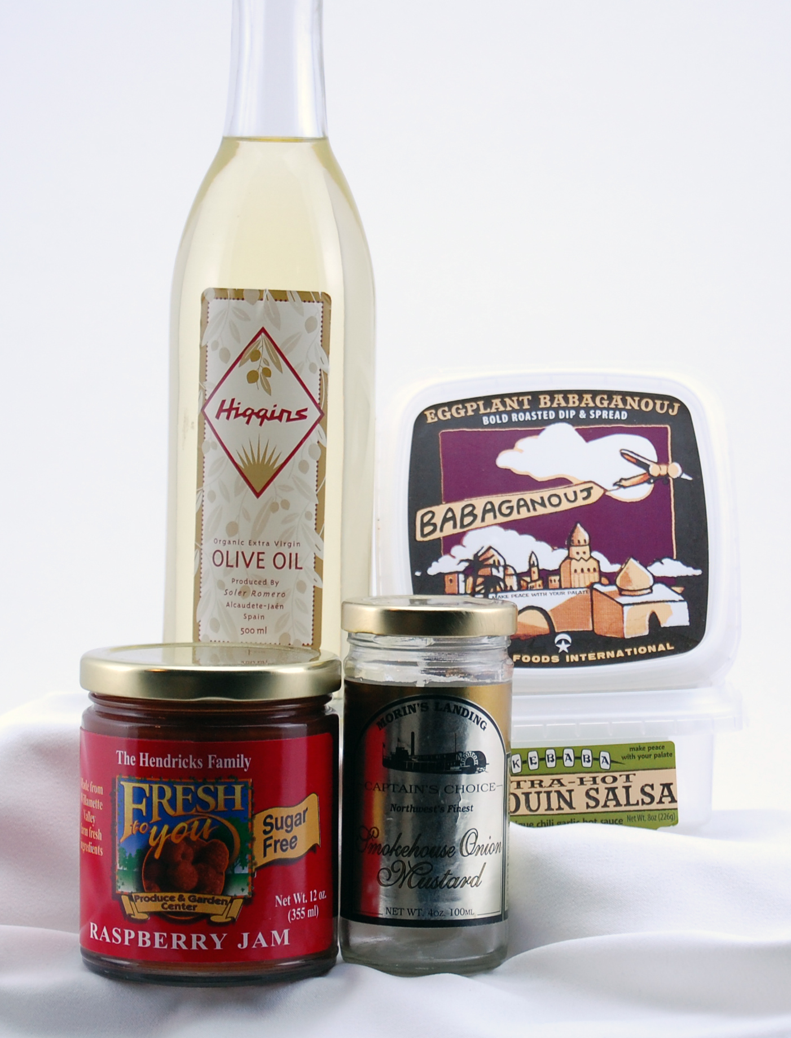
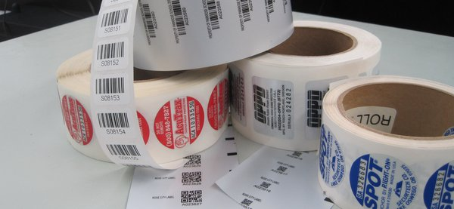
Food Labels
Vitamins
Soaps, Lotions
Olive Oil, Sauces
Jam and Jelly
Cider, Tea, Soda
Variable Barcodes
Notes:
30

Slide 31
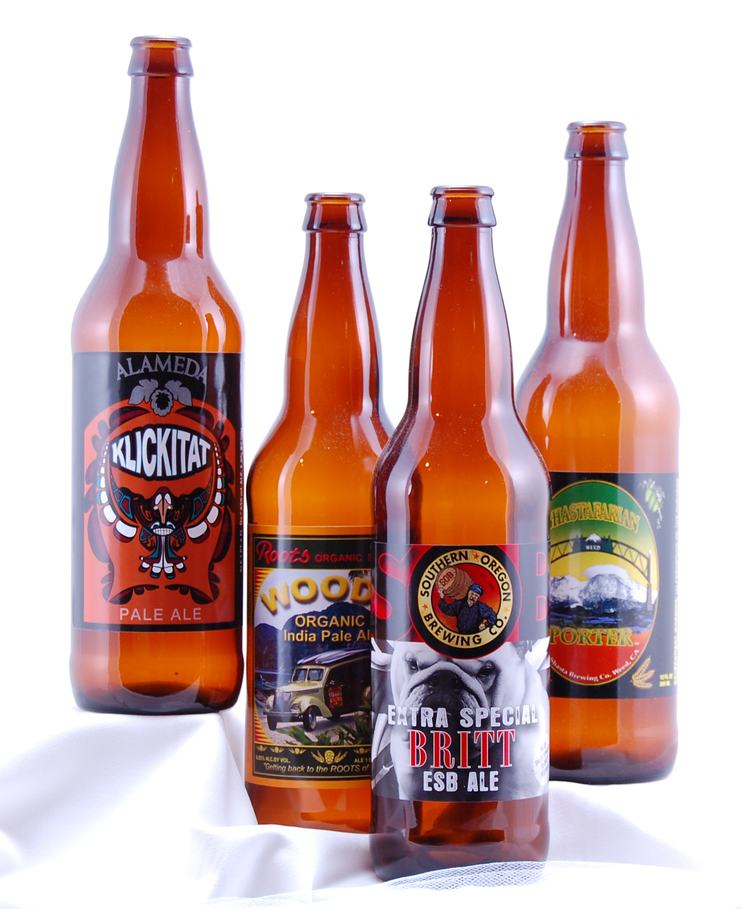
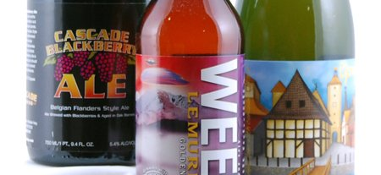
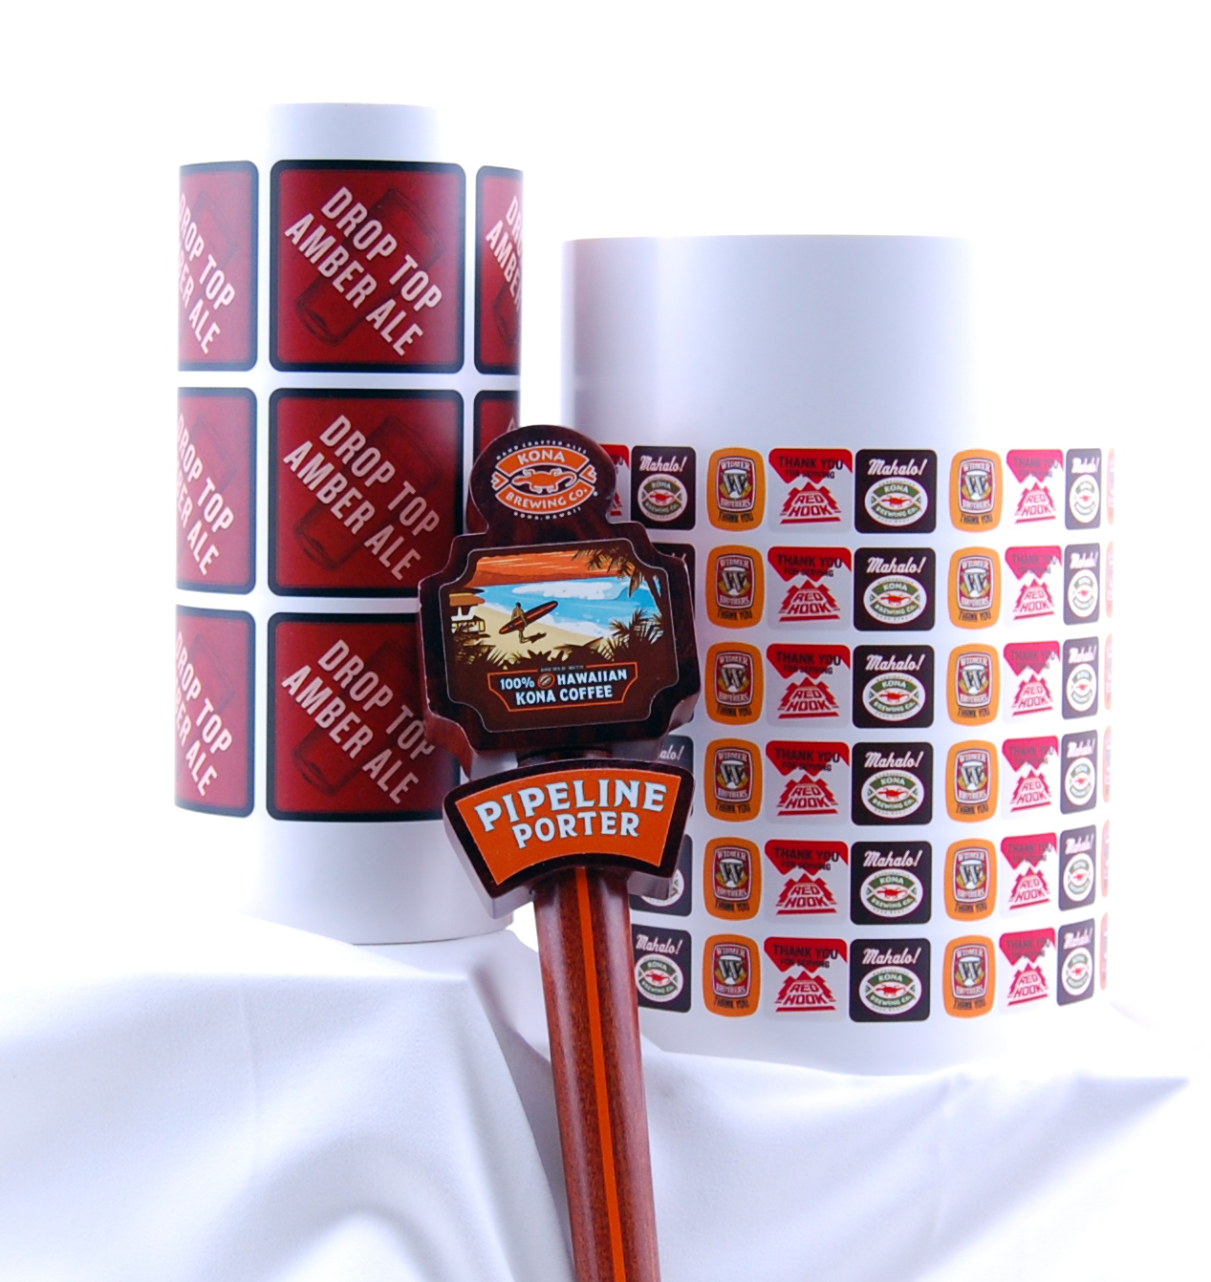
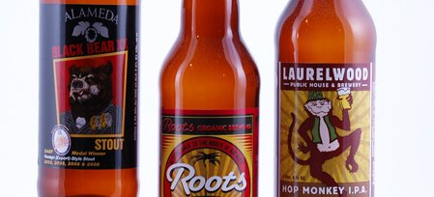
(Oregon) Craft Beer is Booming!
Future
Notes:
31

Slide 32
Summary
Our Proud History
Future Generations
Leadership in the Label Business
    Survived 2008 and came back stronger
    Invested in technology and sustainability
    Business is booming
    Optimistic about the future of Family Business

Slide 33
Thank You for Considering Us!
Questions?
Austin Family Business Presentation
June 21, 2013

